Slide 1
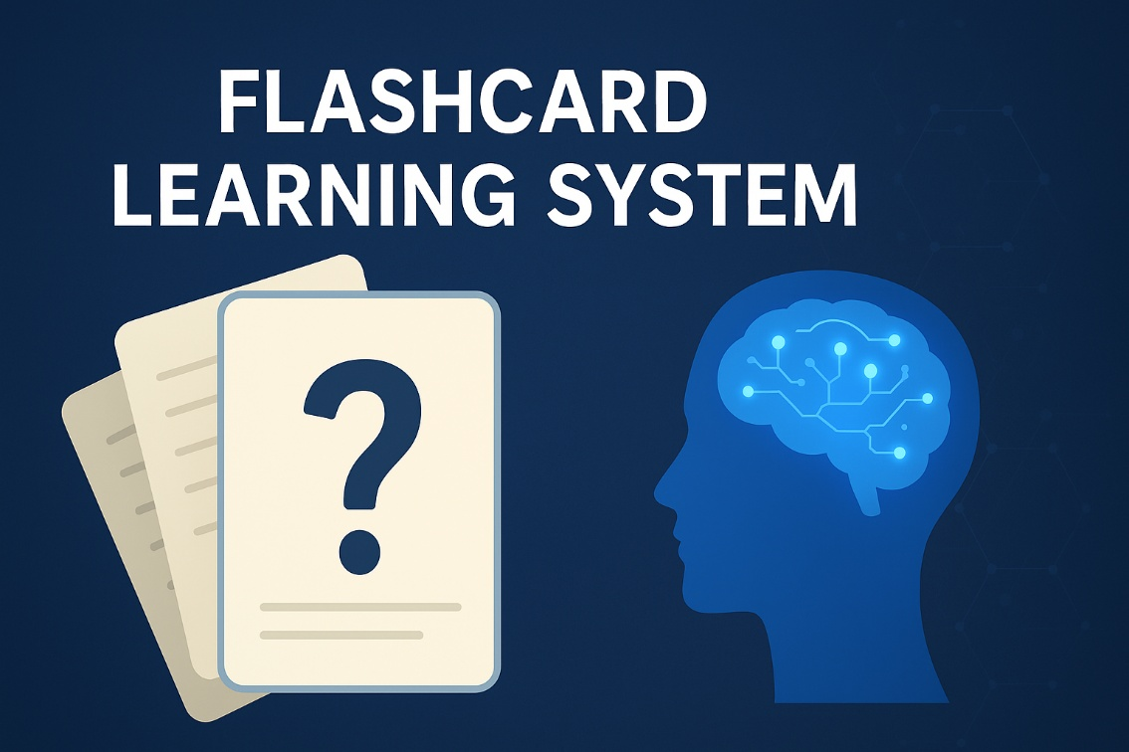
JaVA FLASHCARD LEARNING SYSTEM
Department of Information Technology
Project Member:
Potnooru Madhuri
Deekshit
322103211057
Mentor:
Mr. G. APPAGI
Assistant Professor

Slide 2
index
Abstract
Introduction
Problem Statement
Technology Overview
Dataset
Implementation
Result
Future Enhancement
Conclusion

Slide 3
abstract
The Java Flashcard Learning System is designed to improve learning efficiency using active recall.
Implements the Leitner Method, where flashcards move between levels based on user performance.
Features include flashcard creation, one-cycle study sessions, performance tracking, and CSV-based data storage.
The system provides a lightweight, platform-independent study tool.
Enhances long-term memory retention and helps learners revise concepts in an organized and effective manner.

Slide 4
INTRTODUCTION
Flashcards are a simple and effective learning tool that help in quick revision and memorization. The project digitalizes this method to make studying more organized and interactive.
Importance
Helps learners practice active recall.
Supports systematic revision through spaced repetition.
Reduces cognitive load by breaking concepts into small units.
Main Objective
To develop a flashcard-based study system using Java that enables users to create, review, and manage cards effectively.
Incorporates the Leitner Method, a spaced repetition technique where flashcards are arranged in levels (boxes) based on how well the learner remembers them. Correct answers move cards to higher levels (reviewed less often), while incorrect answers move them back, ensuring focused revision..

Slide 5
PROBLEM STATEMENT
Challenges in Traditional Learning & Revision Methods
Students struggle to retain large amounts of information without a structured revision plan.
Manual flashcards are difficult to organize, update, and track over time.
Lack of personalized repetition leads to forgetting previously learned concepts.
Hard to identify which topics are strong and which need more review.
No automated method to schedule revisions or measure progress.

Slide 6
Why a Flashcard Learning System is a Solution
Encourages active recall, one of the most effective learning techniques.
Uses the Leitner Method, which adjusts revision frequency based on user performance.
Automatically prioritizes difficult cards, improving learning efficiency.
Provides an organized digital platform for creating, storing, and managing study material.
Tracks progress and supports consistent, structured revision across any subject area.

Slide 7
TECHNOLOGY OVERVIEW
Java Programming Language
Core language used to implement the flashcard system.
Provides strong support for Object-Oriented Programming (OOP).
Platform-independent, making the application portable across operating systems.
Java Collections Framework
Used to store and manage flashcards efficiently.
Utilizes ArrayList, HashSet, and Map for card storage, tracking, and statistics.
File Handling (CSV Storage)
Flashcards are saved in a CSV file for permanent storage.
Java I/O and NIO classes (BufferedReader, BufferedWriter, Files, Paths) enable reliable reading and writing.

Slide 8
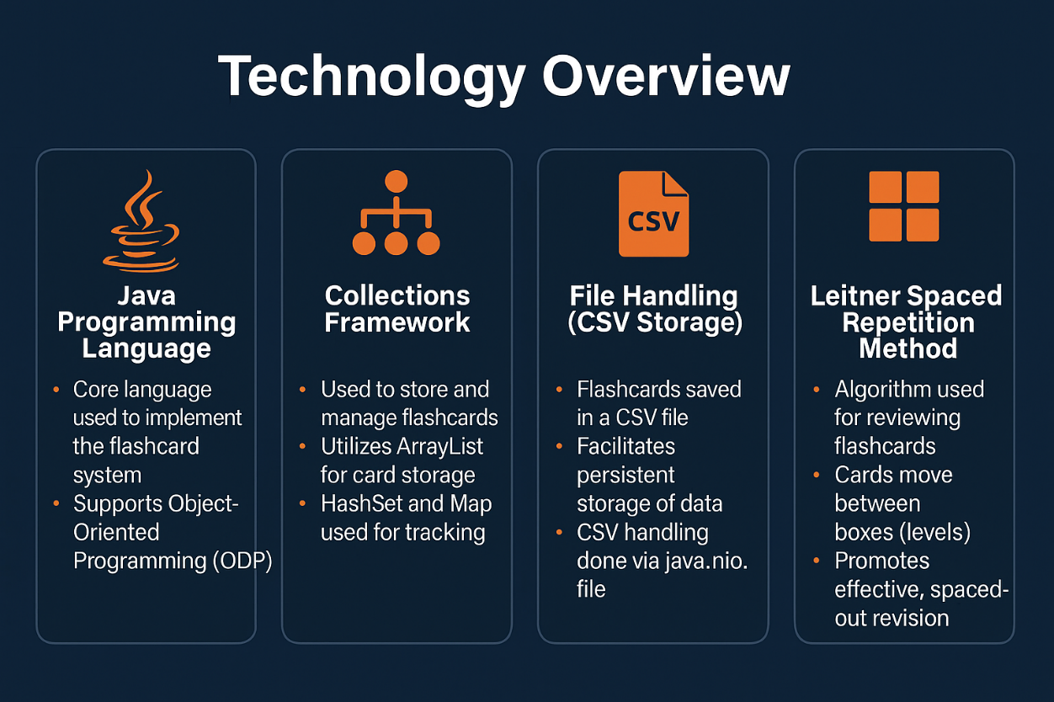
Randomization & Weighted Selection
Uses Java’s Random class to pick flashcards based on their Leitner box weights.
Ensures difficult cards appear more frequently.
Leitner Spaced Repetition Method
Integrated into the logic for promoting/demoting cards.
Ensures systematic and effective revision by adjusting card frequency.

Slide 9
DATASET
All data is created by the user in the form of flashcards during application use and later stored in csv file.
Data Structure
Each flashcard consists of:
Front – The question or concept. Back – The answer or explanation. Box Level – The Leitner method level (1–5), updated based on performance.
Storage Format
Flashcards are stored in a CSV file (flashcards.csv). Each row represents a flashcard in the format: front | back | box
Purpose of the Dataset
Maintains user-created study material across sessions. Supports spaced repetition by tracking the learning level of each card. Enables seamless loading, saving, and updating of flashcards.

Slide 10
implementation
1. System Design: Structured into Flashcard, Deck, and Application modules using OOP.
2. Flashcard Module: Stores question, answer, and Leitner level. Supports updating levels and CSV conversion.
3. Deck Module: Manages flashcards using Java Collections. Handles saving/loading and weighted card selection.
4. Study Session Logic: Implements a one-cycle study flow with no repeats. Uses the Leitner Method to adjust card difficulty.
5. User Interface: Simple menu-driven console for adding, studying, and viewing cards.
6. Testing: Validated storage, study flow, and error handling.

Slide 11
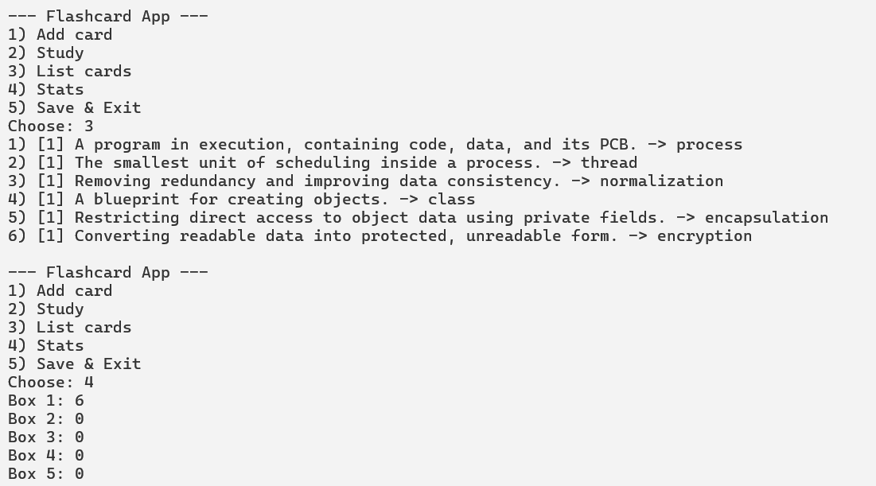
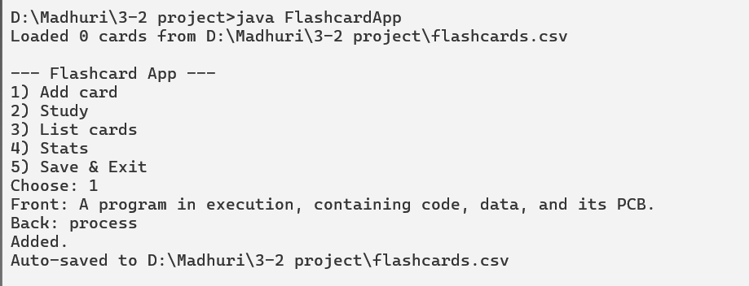
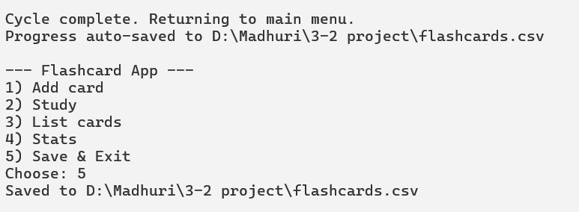
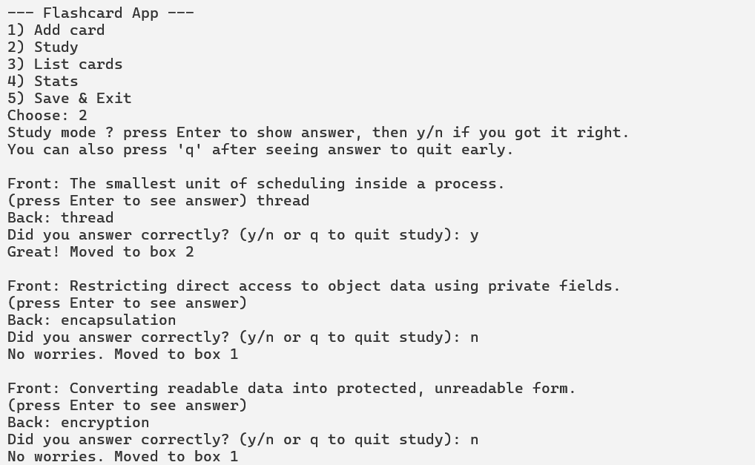
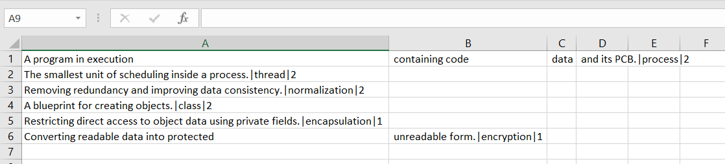
result

Slide 12
Future enhancement
Add a graphical user interface for easier interaction.
Support multiple decks to organize flashcards by topic.
Provide options to edit or delete existing flashcards.
Integrate advanced spaced-repetition algorithms for better scheduling.
Include basic progress tracking and performance statistics.
Add multimedia support (images/audio) for richer flashcards.

Slide 13
conclusion
The Flashcard Learning System provides an effective way to practice active recall and spaced repetition.
The integration of the Leitner Method helps learners focus more on difficult topics.
Java’s object-oriented design and file handling made the system simple, portable, and easy to maintain.
The application allows users to create, study, and manage flashcards efficiently.
Overall, the project demonstrates how programming can be used to build practical learning tools that support long-term memory retention.

Slide 14
Thank you

